Slide 1

MAJOR PROJECT-I PRESENTATION
EDUMATRIX app
GANDHI INSTITUTE OF ENGINEERING & TECHNOLOGY UNIVERSITY,GUNUPUR,ODISHA
Presented By:
23CSE540- GAYATRI DHAL
23CSE706- RANJEET SINGH BAGHEL
23CSE700- ARUN KUMAR BISOYI
Under the Guidance of
Mr. Himansu Barik
Dept. of CSE
GIET University ,Gunupur

Slide 2
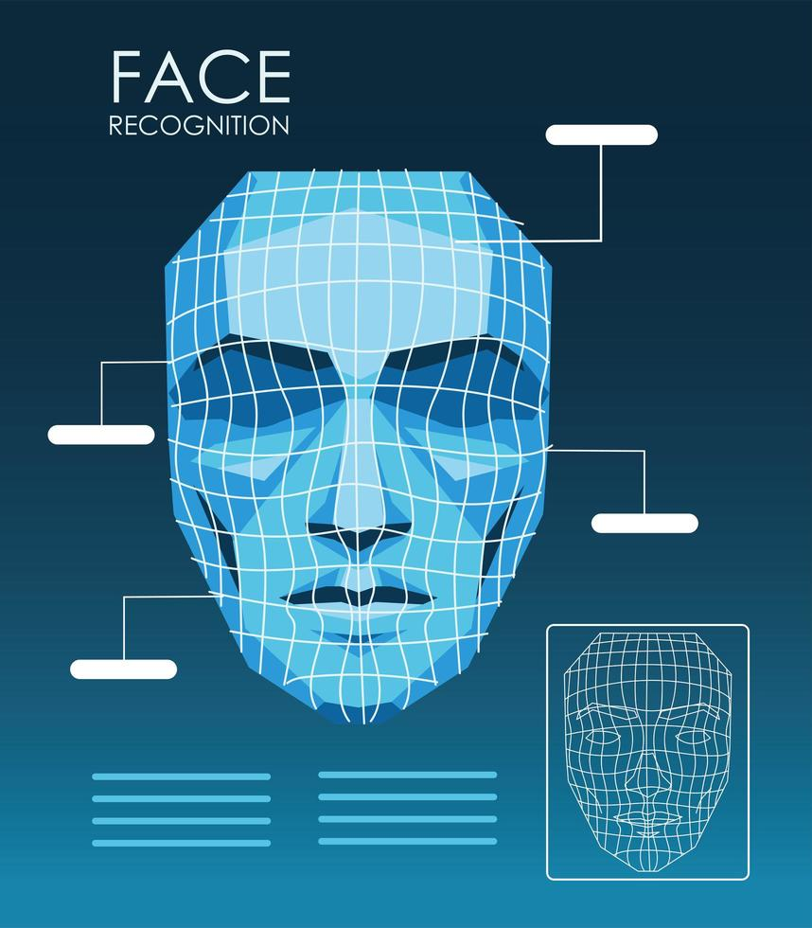
Contents:-
1. Problem Statement
2. Introduction
3. Technology Used
4. Features
5. Machine Learning Approach
6. Diagrams
7. Model Evaluation & Metrices
8. Future Enhancement
9.Limitations
10.Conclusion
11.References

Slide 3

1.PROBLEM STATEMENT
Manual attendance tracking is time-consuming, error-prone, and vulnerable to proxy abuse, lacking real-time accuracy.
Students struggle with disorganized timetables and no personalized AI-driven study planners, leading to poor time management and missed deadlines.
Exam scheduling, performance tracking, and result management rely on fragmented paper or spreadsheet systems, causing delays and inaccuracies.
Generating quizzes from syllabus is manual and inconsistent, making preparation inefficient for both students and faculty.
Academic calendars are static and hard to access, resulting in confusion over events, holidays, and deadlines.
Leave applications involve cumbersome paperwork or emails, with no centralized tracking or approval workflows.

Slide 4
2.INTRODUCTION
Managing university life can be challenging, so our EduMatrix(AI Campus Operations and Career Readiness Engine by Using Android App ) is designed to make it simple, smart, and connected. It brings students, teachers, and guardians onto one platform with features like group chats, personal messaging, and proctor meetings for better communication and support.
With tools like an AI study planner, attendance tracking, resume builder, brain teaser, placement tracker and an academic calendar, the app enhances learning and productivity, creating a more organized and student-friendly experience.

Slide 5
3.TECHNOLOGY USED
Frontend: Android (Kotlin, Jetpack Compose)
Backend: Python with Fast API
Face Detection & Recognition: OpenCV, ML Kit , face recognition
Database: SQL (via SQL Alchemy), Room (local storage)
Architecture: MVVM and Clean Architecture
Security: JWT Authentication, B crypt password hashing

Slide 6
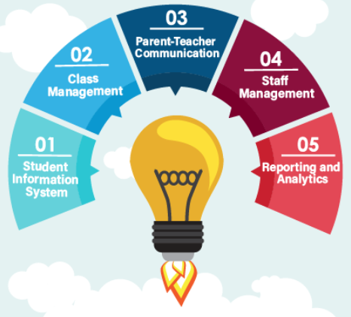
4.FEATURES
Easy communication between students and teachers
Guidance and mentorship support through proctor meetings
Direct interaction with teachers
Interactive learning through brain teasers
Track and view attendance records
Updates and notifications sent to guardians
Quick access to course syllabus
Smart and personalized study planning

Slide 7

Machine learning approach
Our system uses machine learning to analyze student data such as attendance, performance, and syllabus. Based on these patterns, it generates personalized study plans and smart recommendations. It also uses AI to create quizzes automatically from the syllabus. The system continuously learns from student progress to improve accuracy and provide better support over time.

Slide 8
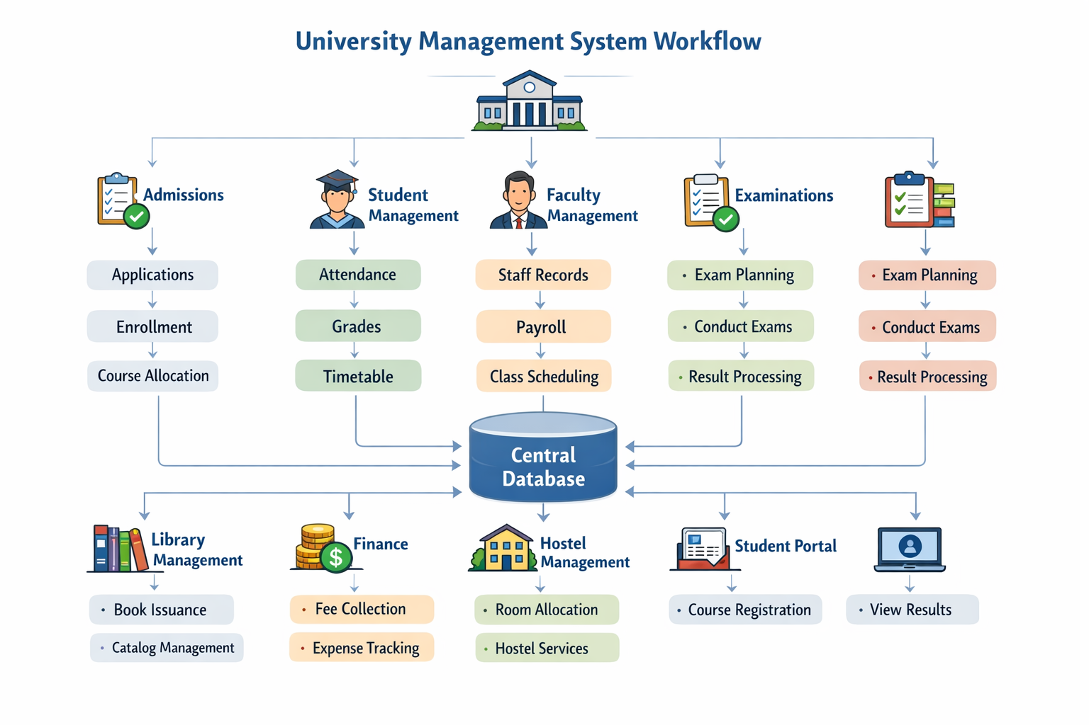
EDUMATRIX APP Workflow
The system starts by collecting student and academic data such as attendance, syllabus, and performance. This data is processed to manage communication, scheduling, and academic activities like chats, meetings, and calendar updates. The AI module then analyzes the data to generate study plans, quizzes, and recommendations. Finally, the system displays results, tracks progress, and sends updates to students, teachers, and guardians for continuous improvement.

Slide 9
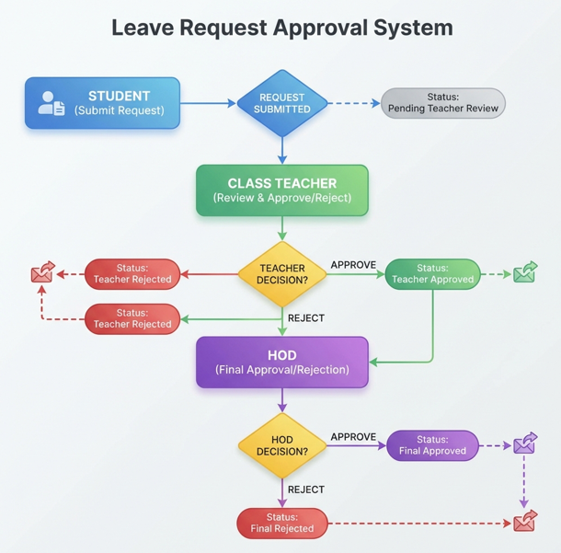
Leave Request Approval Workflow
The process starts when the student submits a leave request through the app. The request first goes to the class teacher for review. The teacher can either approve or reject the request. If the teacher rejects it, the leave is marked as teacher rejected. If the teacher approves, the request is forwarded to the HOD for final review. The HOD then approves or rejects the request. Based on this decision, the leave status is marked as final approved or final rejected, and the student is notified accordingly.

Slide 10
Model evaluation and metrices
The performance of the face recognition model is evaluated using:
Accuracy: Measures how correctly the model makes predictions
Precision: Evaluates the quality of relevant recommendations
Recall: Measures how well the model captures all important cases
F1-Score:Balances precision and recall for overall performance
User Feedback – Checks user satisfaction and usefulness
Performance Improvement – Tracks student progress after using the system.

Slide 11

Future enhancement
Mask-aware face recognition
Parent portal for monitoring attendance
Push notifications using Firebase
Advanced analytics using machine learning
Cloud deployment for scalability

Slide 12
Limitations
Depends on quality and accuracy of input data
Face recognition may be affected by masks or extreme angles
AI predictions may not always be fully accurate
Privacy and security concerns of student data
Performance depends on device quality

Slide 13
Conclusion
The EduMatrix brings everything together in one place, making academic life simpler, more organized, and more connected. By combining smart AI features with everyday tools like communication, planning, and tracking, it not only saves time but also supports better learning and decision-making. Overall, it creates a more efficient and student-friendly environment for both students and teachers.

